Slide 1
Raspberry Pi GPIO + MCS Cloud

Slide 2
DHT-11 溫溼度感應器

Slide 3
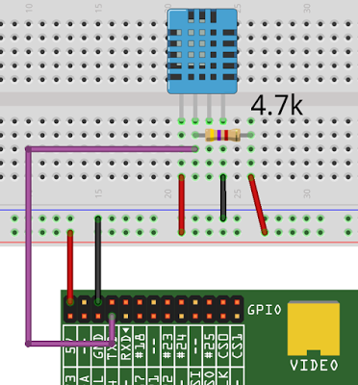
Reference
http://yehnan.blogspot.tw/2015/05/raspberry-pidht11.html

Slide 4
Packages
先安裝所需套件： $ sudo apt-get update $ sudo apt-get install build-essential python-dev 然後下載，進入該目錄： $ git clone https://github.com/zgjh/Adafruit_Python_DHT.git $ cd Adafruit_Python_DHT 安裝： $ sudo python setup.py install 接著就能讀取DHT11了，執行寫好的範例Python程式： $ cd examples $ sudo ./AdafruitDHT.py 11 4 Temp=27.0*C Humidity=81.0% 其中參數11代表DHT11，4代表我把它接到Raspberry Pi的GPIO 4。

Slide 5
Modify AdafruitDHT.py
# Try to grab a sensor reading. Use the read_retry method which will retry up
# to 15 times to get a sensor reading (waiting 2 seconds between each retry).
humidity, temperature = Adafruit_DHT.read_retry(sensor, pin)
# Un-comment the line below to convert the temperature to Fahrenheit.
# temperature = temperature * 9/5.0 + 32
# Note that sometimes you won't get a reading and
# the results will be null (because Linux can't
# guarantee the timing of calls to read the sensor).
# If this happens try again!
if humidity is not None and temperature is not None:
print('Temp={0:0.1f}* Humidity={1:0.1f}%'.format(temperature, humidity))
else:
print('Failed to get reading. Try again!')
sys.exit(1)

Slide 6
Modify AdafruitDHT.py
While true:
humidity, temperature = Adafruit_DHT.read_retry(sensor, pin)
if humidity is not None and temperature is not None:
print('Temp={0:0.1f}* Humidity={1:0.1f}%'.format(temperature, humidity))
else:
print('Failed to get reading. Try again!')
sys.exit(1)

Slide 7
CHECK POINT #1
讓 DHT-11 可以一直量測溫溼度

Slide 8
MCS Cloud

Slide 9
Reference
http://oranwind.org/-linkit-smart-7688-chuan-song-sensor-data-dao-mediatek-cloud-sandbox-mcs/

Slide 10
MediaTek Cloud Sandbox (MCS) 端

Slide 11
Step 1:
到 MediaTek Cloud Sandbox (MCS) 網站申請帳號
https://mcs.mediatek.com

Slide 12

Step 2: Login

Slide 13
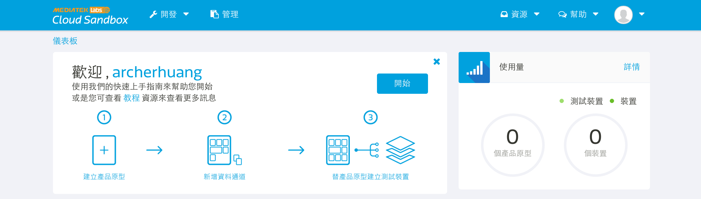
Step 3:點擊 開始

Slide 14
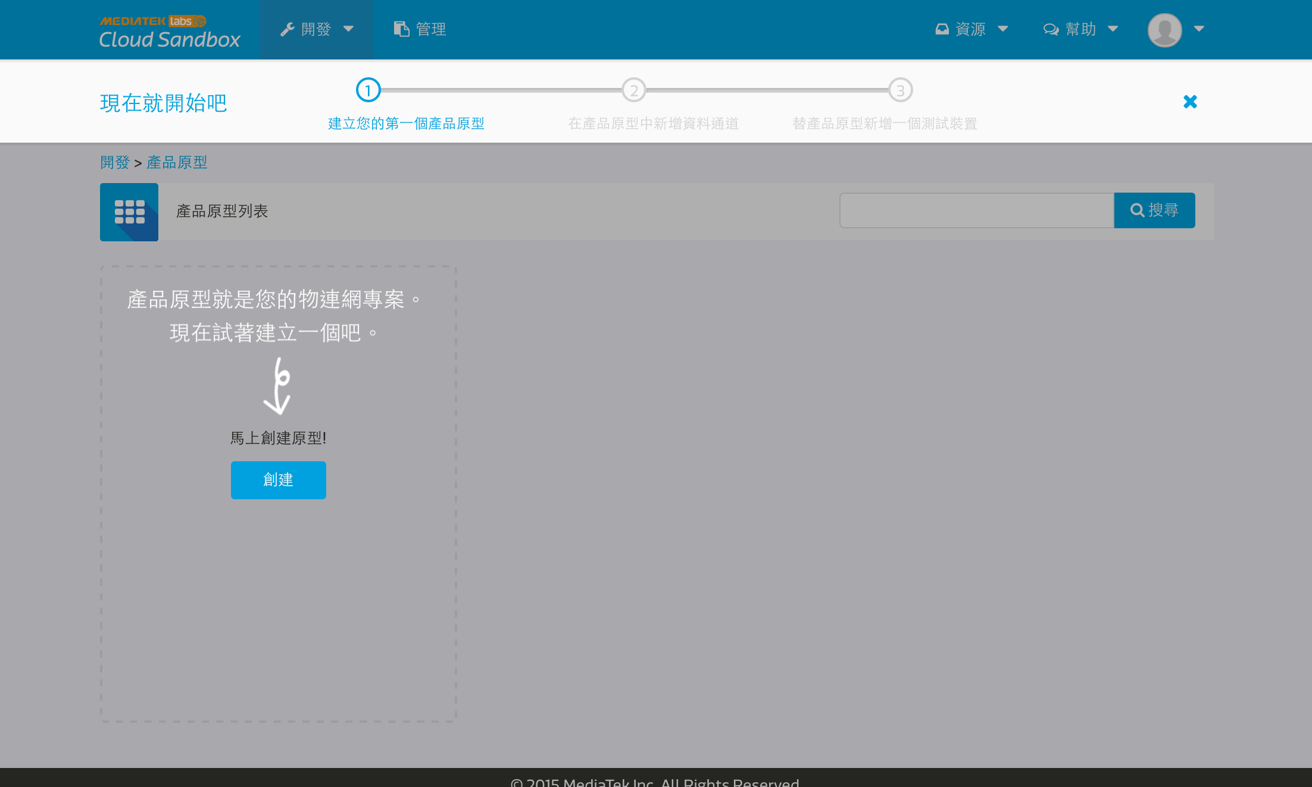
Step 4: 開發 -> 產品原型

Slide 15
Step 5.
輸入 產品原型名稱、產品原型版本、硬體平台、產業、應用程式 再按儲存
硬體平台raspberry pi

Slide 16
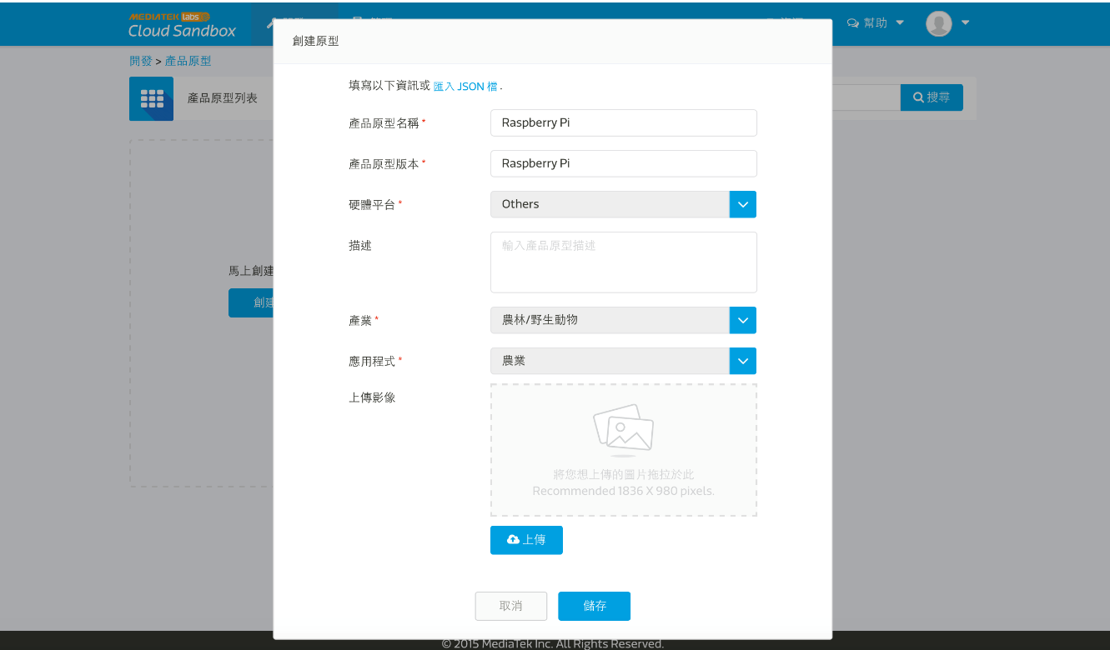

Slide 17
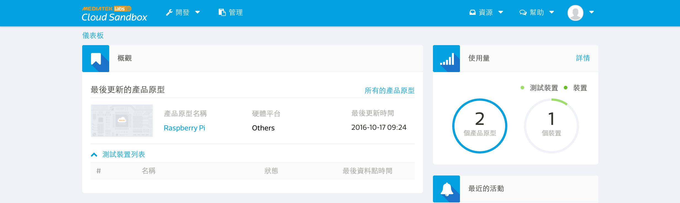
Step 6
點擊 Last updated prototype 中的 raspberry pi

Slide 18
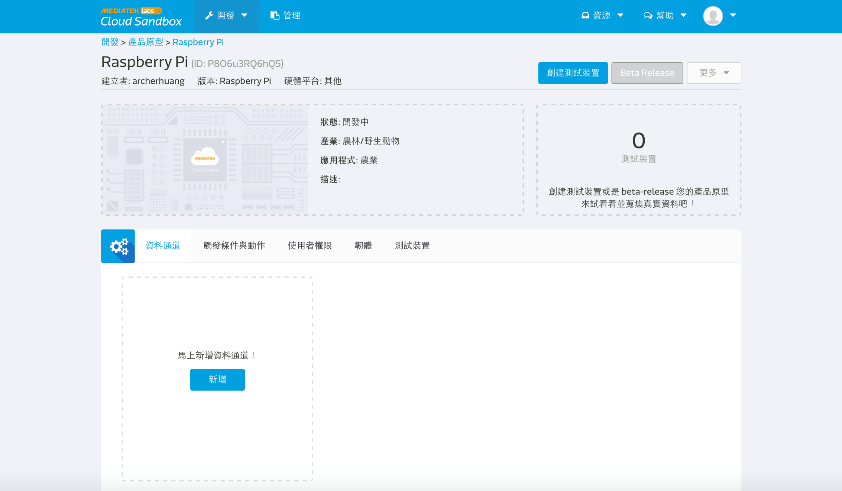
Step 7 Add Data Channel

Slide 19
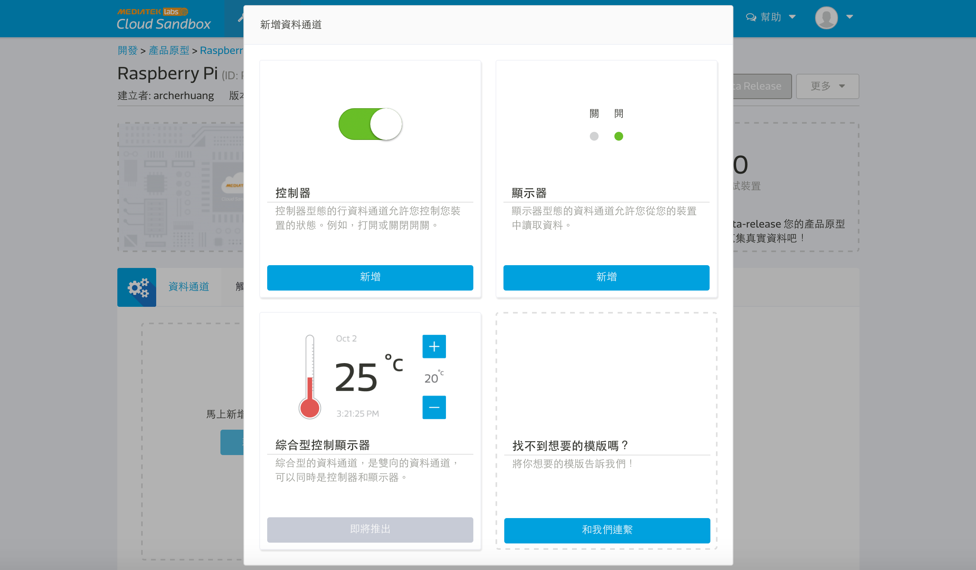
Step 8. Display -> Add

Slide 20
Step 9
輸入 Temperature 的 Data channel name、Data channel Id、Data type、Unit 再按 Save

Slide 21
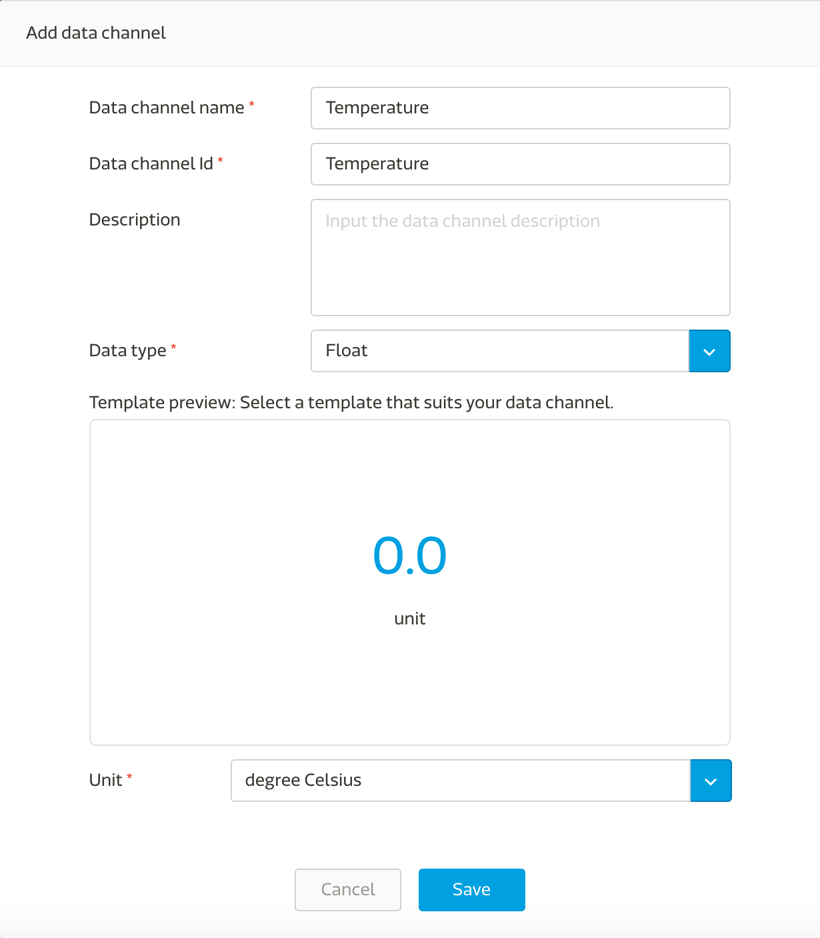

Slide 22
Step 10
Repeat Step 7 – 8.
Add data channel

Slide 23
Step 11
輸入 Humidity 的 Data channel name、Data channel Id、Data type、Unit 再按 Save

Slide 24


Slide 25
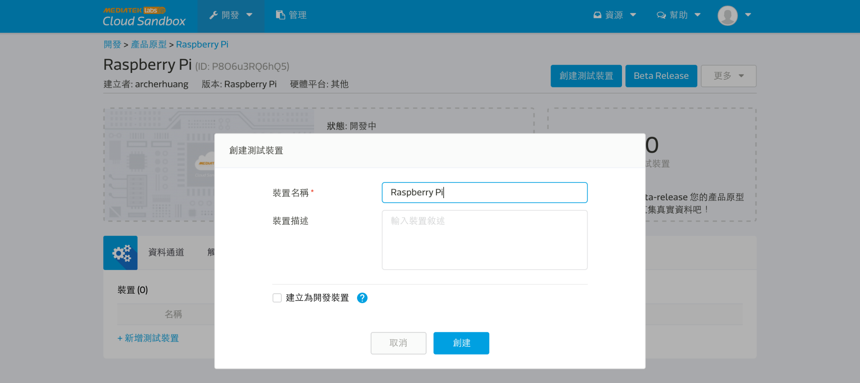
Step 12
點擊 Create Test device 輸入 raspberry pi

Slide 26
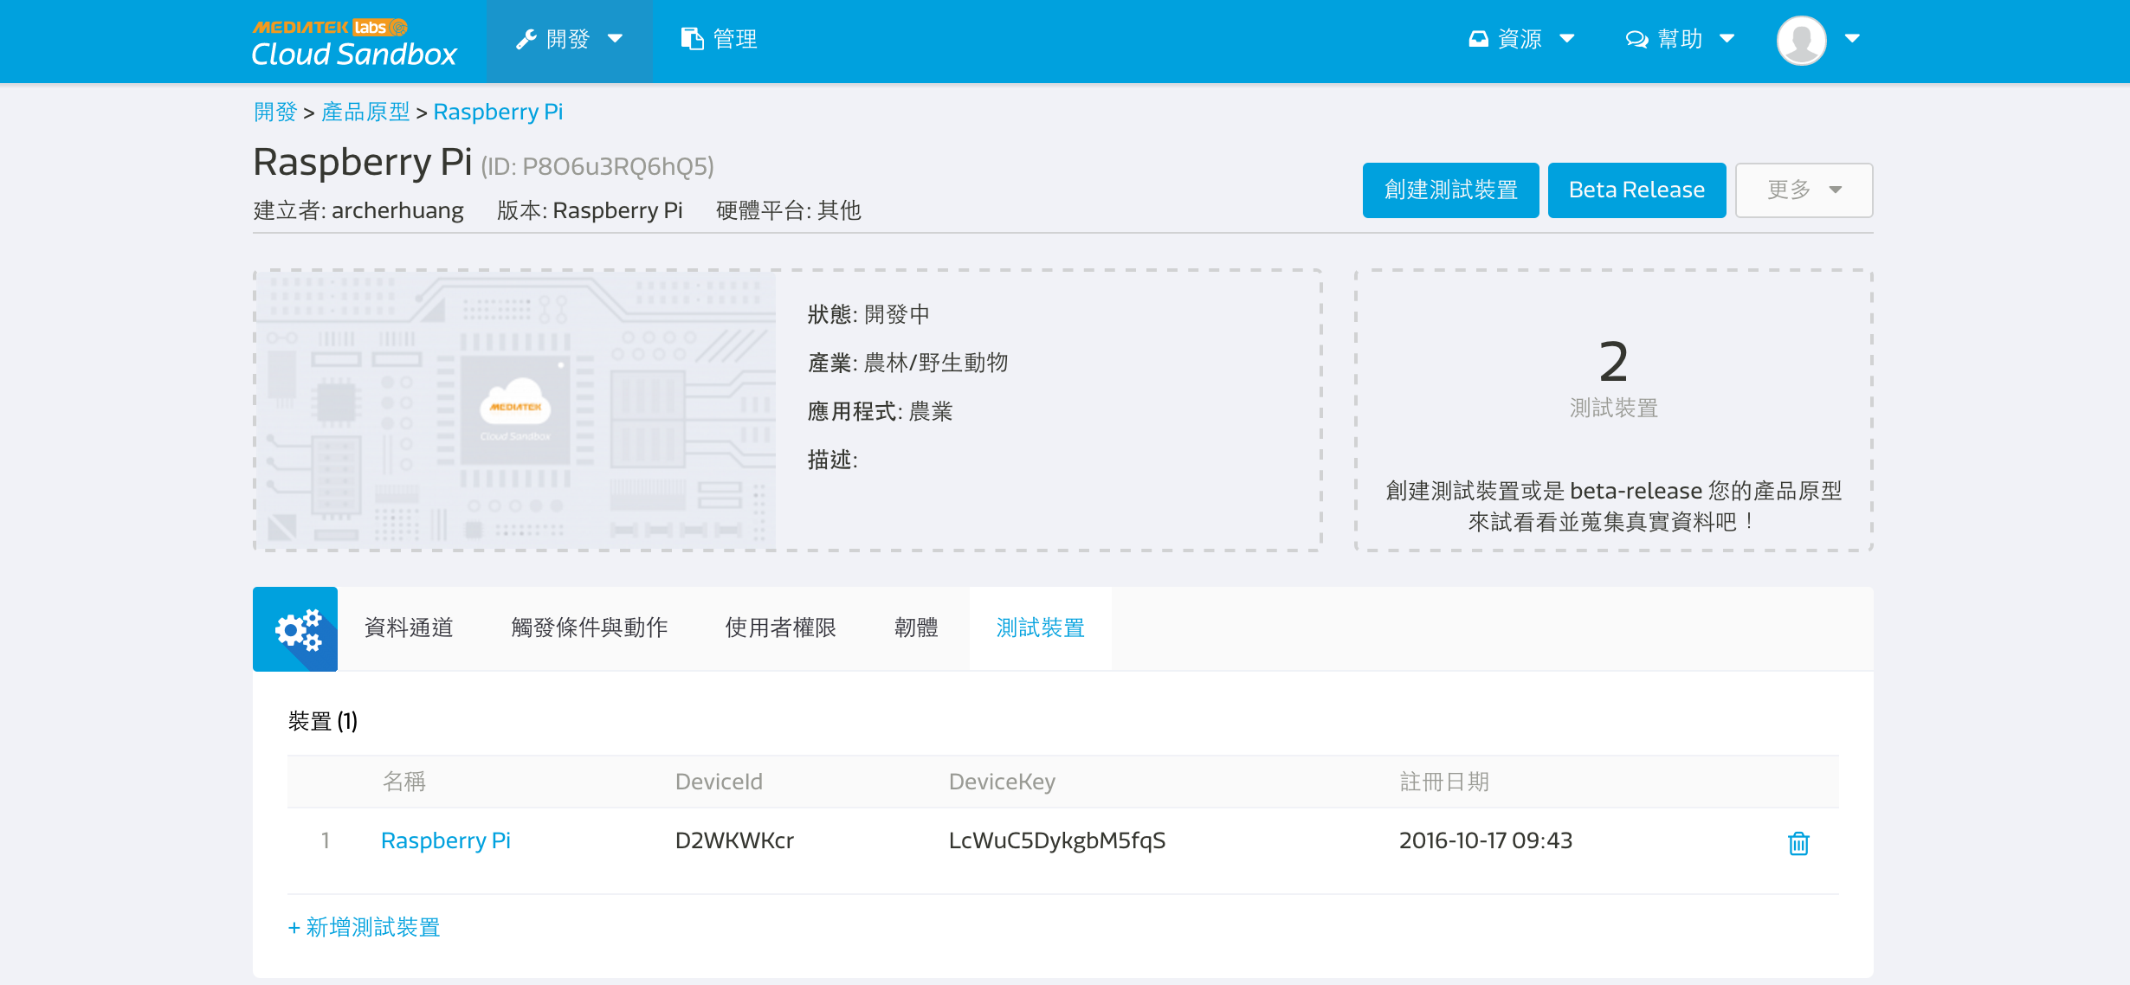
點擊下方 裝置 中的 Raspberry Pi
取得 DeviceId 與 DeviceKey

Slide 27
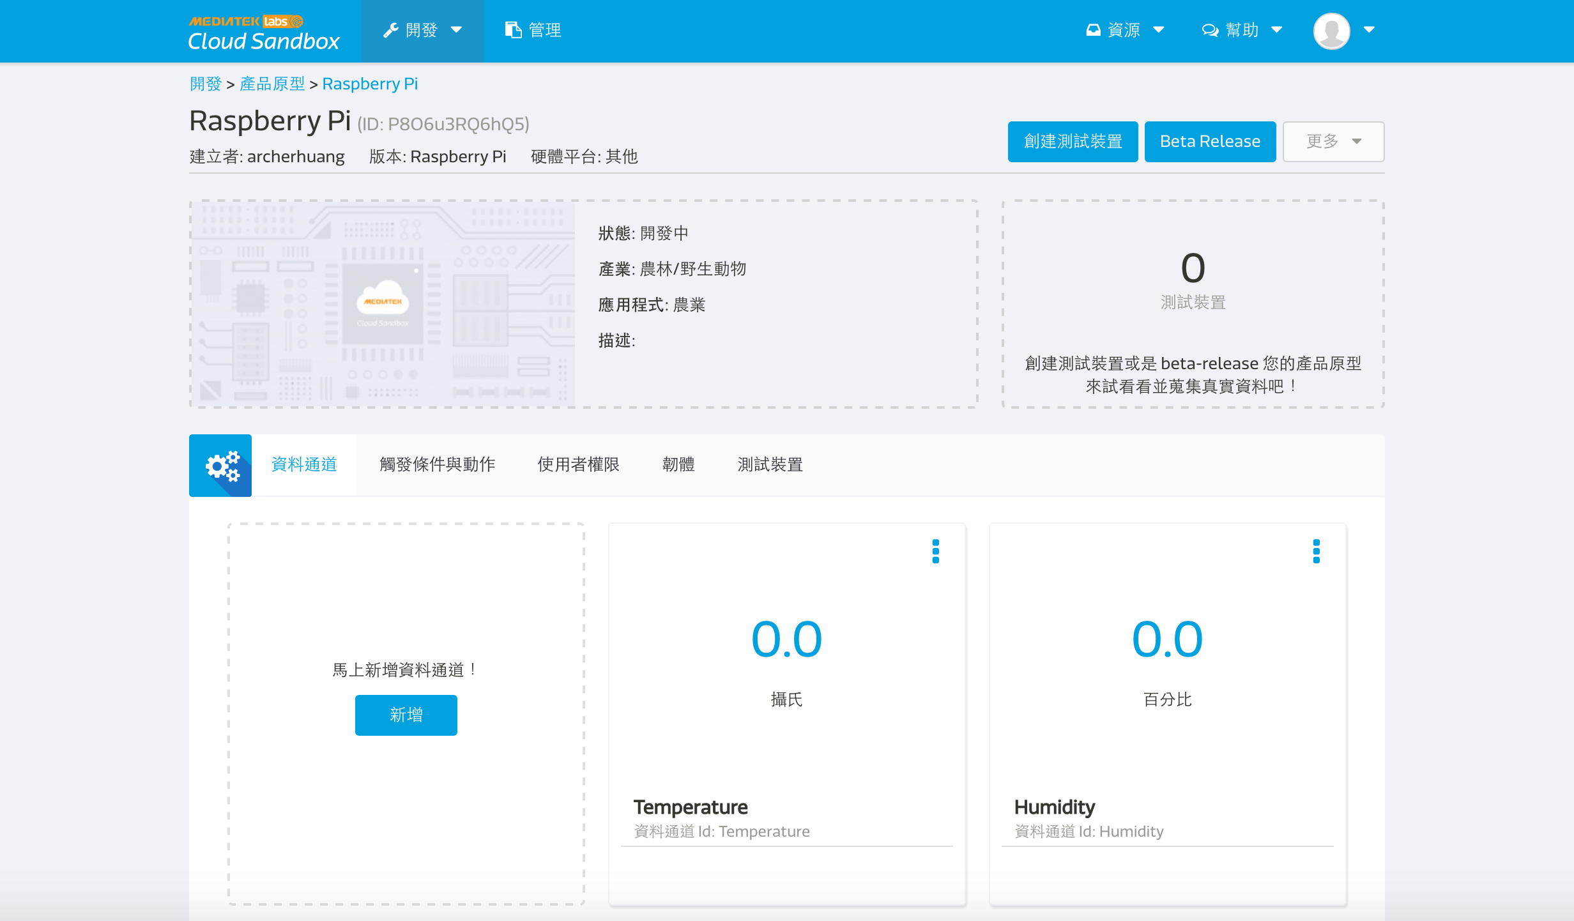

Slide 28
Step 13 – Modify AdafruitDHT.py add post_to_mcs function
import time
import sys
import httplib, urllib
import json
deviceId = "D2WKWKcr “
deviceKey = “LcWuC5DykgbM5fqS“
def post_to_mcs(payload):
headers = {"Content-type": "application/json", "deviceKey": deviceKey}
not_connected = 1
while (not_connected):
try:
conn = httplib.HTTPConnection("api.mediatek.com:80")
conn.connect()
not_connected = 0
except (httplib.HTTPException, socket.error) as ex:
print "Error: %s" % ex time.sleep(10)
# sleep 10 seconds
conn.request("POST", "/mcs/v2/devices/" + deviceId + "/datapoints", json.dumps(payload), headers)
response = conn.getresponse()
print( response.status, response.reason, json.dumps(payload), time.strftime("%c"))
data = response.read()
conn.close()

Slide 29
Modify AdafruitDHT.py
While true:
h0, t0= Adafruit_DHT.read_retry(sensor, pin)
if humidity is not None and temperature is not None:
print('Temp={0:0.1f}* Humidity={1:0.1f}%'.format(temperature, humidity))
payload = {"datapoints":[{"dataChnId":"Humidity","values":{"value":h0}},
{"dataChnId":"Temperature","values":{"value":t0}}]}
post_to_mcs(payload)
time.sleep(10)
else:
print('Failed to get reading. Try again!')
sys.exit(1)

Slide 30
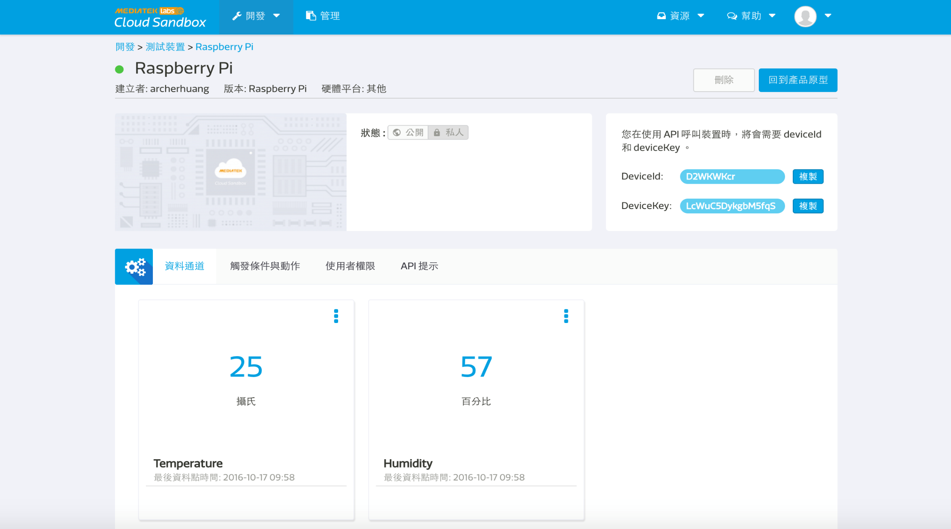

Slide 31
CHECK POINT 2
MCS Cloud 持續顯示溫濕度

Slide 32
MCS Cloud 顯示開關狀態

Slide 33
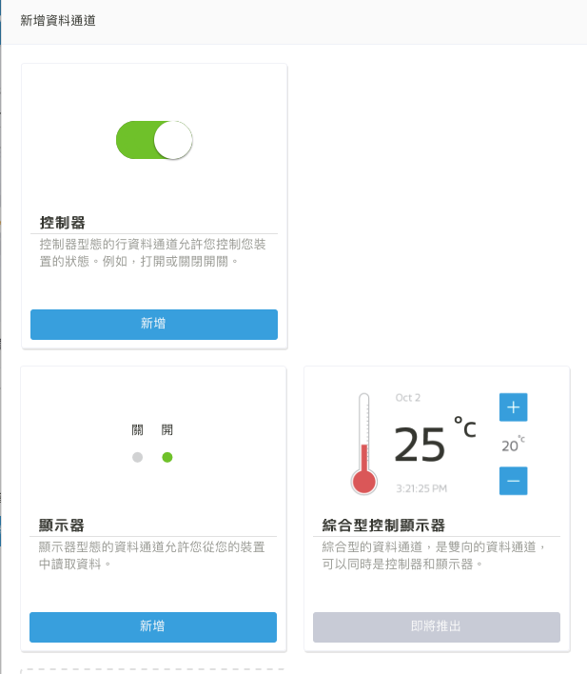
新增資料通道 -> 顯示器

Slide 34
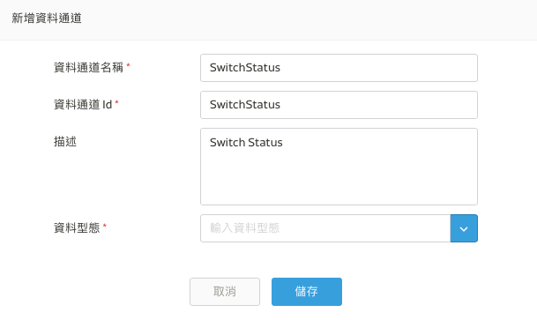
資料型態 -> 開關

Slide 35

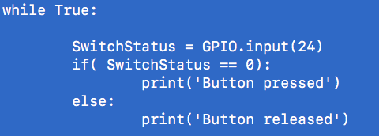
Python 讀取 GPIO 狀態

Slide 36
將開關狀態上傳 MCS Cloud

Slide 37
CHECK POINT 3
MCS Cloud 持續顯示溫濕度及開關狀態

Slide 38
MCS Cloud 控制 LED

Slide 39
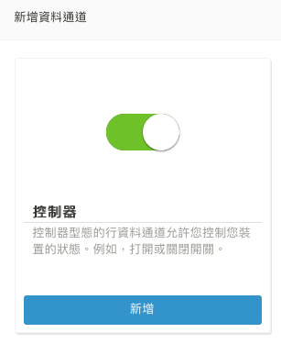
新增資料通道 控制器

Slide 40
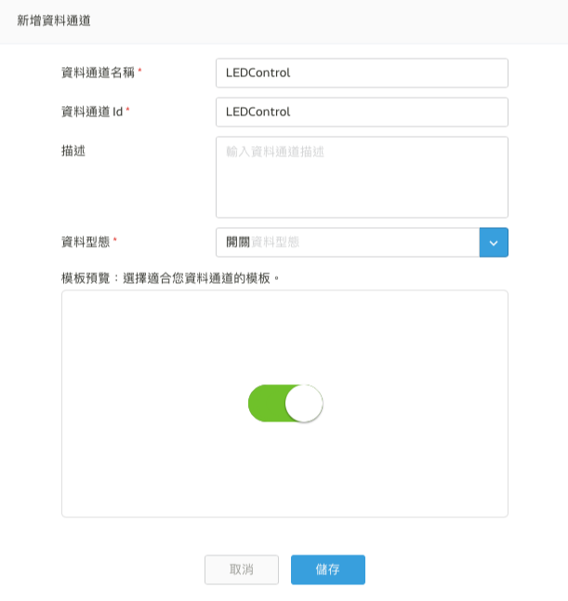
資料通道 -> LEDControl

Slide 41
Reference
http://draw-bruce.blogspot.tw/2016/01/iot10-mediatek-cloud-sandbox.html

Slide 42
CHECK POINT 4
MCS Cloud 直接控制 LED

